Slide 1
E-commerce Orders analysis
Mobile accessories

Slide 2
Problem statement
The company wanted to analyze its E-Commerce sales data across multiple countries to understand sales performance, customer behavior, order trends, and target achievement.
The objective of this project was to clean and transform the data, create a proper data model, and build an interactive Power BI dashboard that helps management track sales targets, identify top-performing sales teams and managers, analyze customer categories, and improve business decision-making

Slide 3
Data cleaning
Using filter empty values removed
Handled missing values
Create data model
Create DAX measures and column
Combined Sales Manger first name & last name

Slide 4
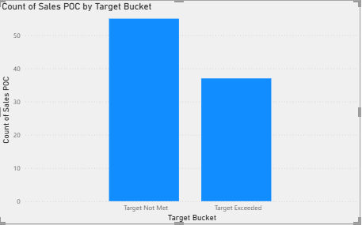
Target buckets-target not met, target met and target exceeded how many sales Poc achieved there target.
Target not met-56
Target exceeded-36

Slide 5
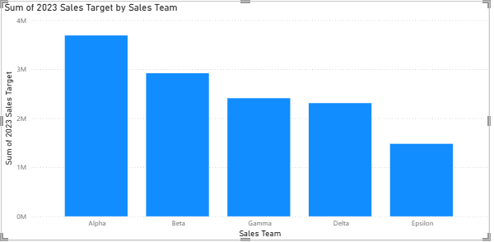
Which sales teams were given how much total sales targets in total Alpha sales team was assigned the highest targets alpha - 3690000 Beta - 2920000 gamma - 2410000 delta - 2310000 epsilon- 1480000

Slide 6
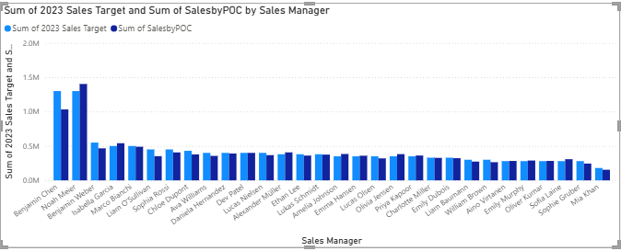
which sales manager was given the highest Target? Did he/she meet that Target?
Benjamin Chen and Noah Meier were given the highest target. Benjamin Chen did not meet the sales target while Noah Meier met it.

Slide 7
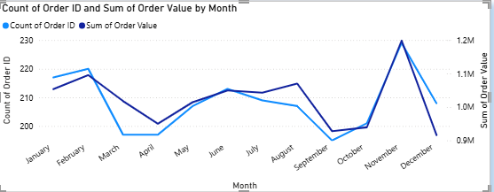
Which month were best for the country from a sales standpoint
February and November recorded strong sales performance.
November had the highest number of orders as well as the highest sales value.

Slide 8
TOOLS IS USED IN VISUALIZATION AND ANALISING
1.filters
2. slicers
3.DAX function
4.different different visualization
5.bookmark
6. drill through
7.mobile view

Slide 9
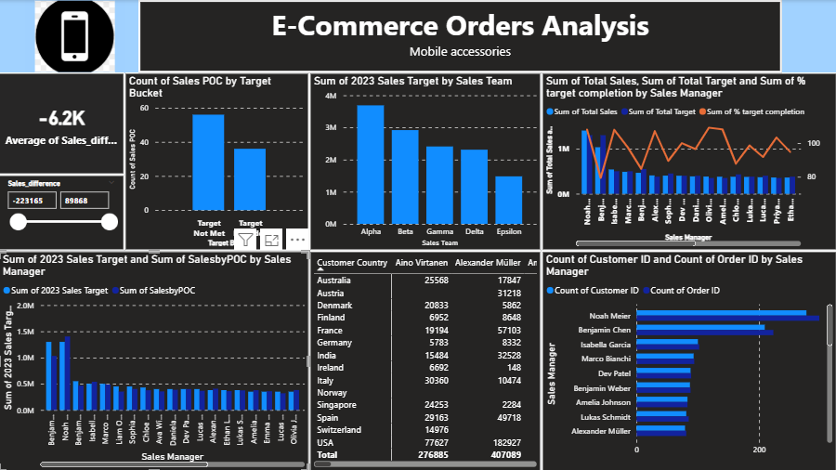
Sales team-

Slide 10
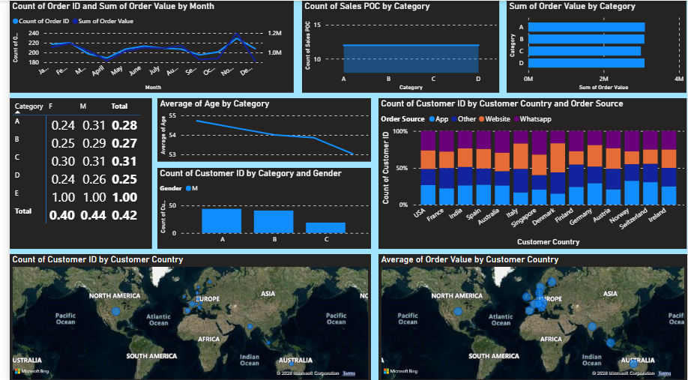
Orders-

Slide 11
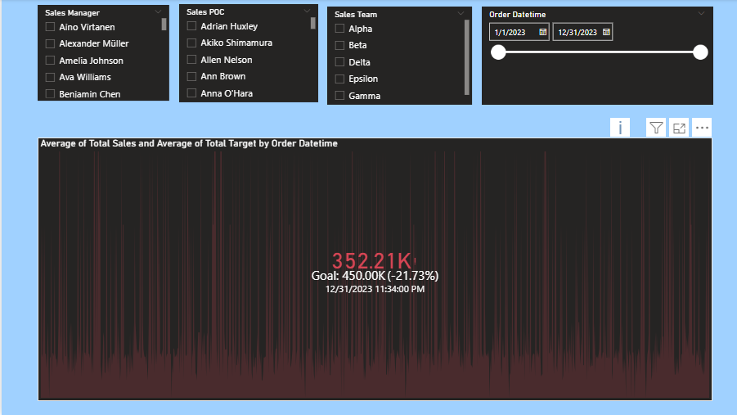
Sales target page-

Slide 12
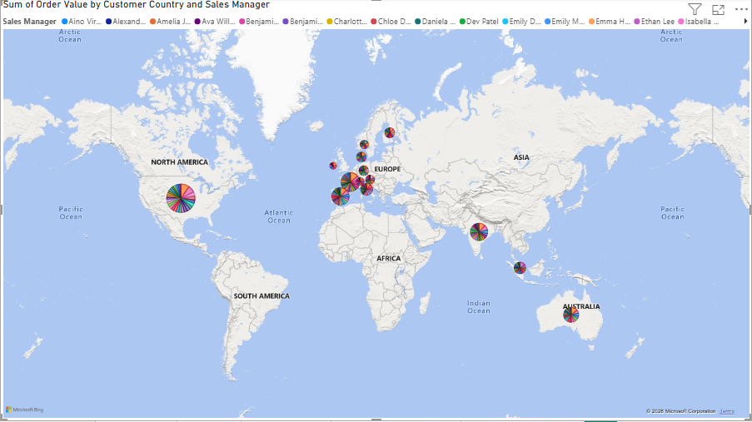
Sales in each country-

Slide 13
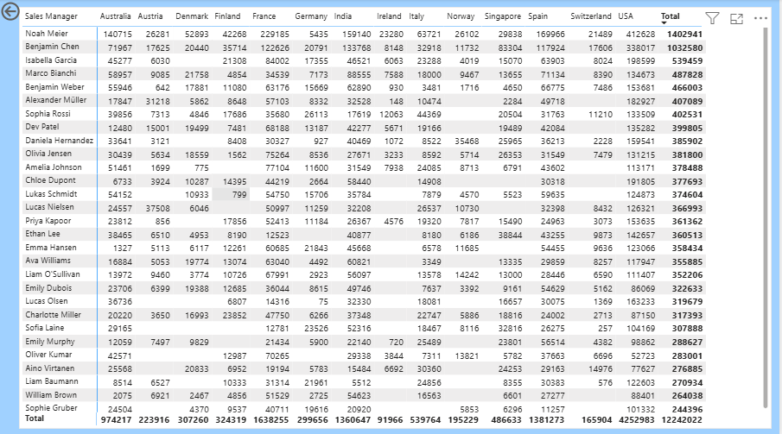
Sm sales by country-

Slide 14
Conclusion-
This project analyzed the sales performance and sales targets of a global e-commerce company using Power BI. The dashboard helped identify monthly sales trends, top-performing countries, customer categories, and sales managers .It also provided insights into order sources and target achievement performance. Interactive visualizations and DAX measures improved data analysis and reporting efficiency. Overall, the project supported better
business decision-making and demand forecasting.

